Slide 1


Machine Learning 10. Perceptron
Xueyuan Gong
School of Intelligent Systems Science and Engineering

Slide 2
Classification
Binary classification: predicting a binary-valued target
Multiclass classification: predicting a discrete(> 2)-valued target
Examples of binary classification
Predict whether a patient has a disease, given the presence or absence of various symptoms
Classify e-mails as spam or non-spam
Predict whether a financial transaction is fraudulent

Slide 3
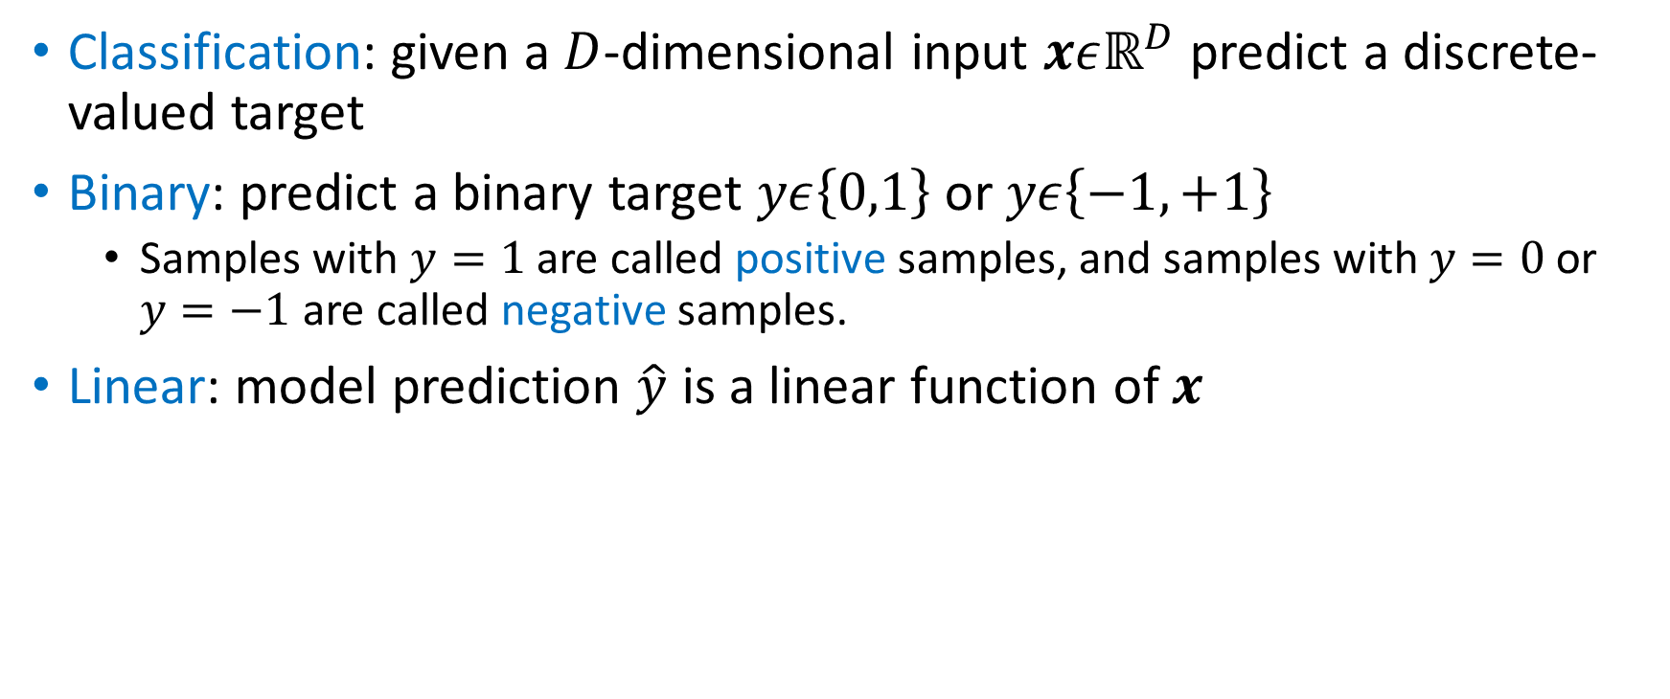
Binary Linear Classification
Classification: given a $D$-dimensional input $xεℝ^{D}$ predict a discrete-valued target
Binary: predict a binary target $yε\left\{0,1\right\}$ or $yε\left\{−1,+1\right\}$
Samples with $y=1$ are called positive samples, and samples with $y=0$ or $y=−1$ are called negative samples.
Linear: model prediction $\hat{y}$ is a linear function of $x$

Slide 4
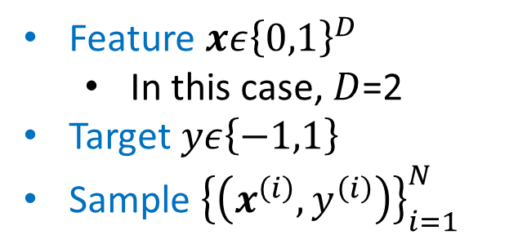
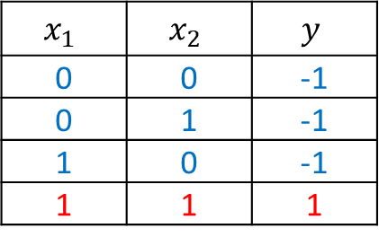
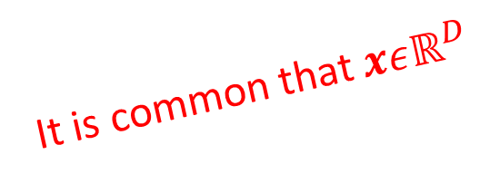
AND Problem
Dataset
Feature $xε{\left\{0,1\right\}}^{D}$
In this case, $D$=2
Target $yε\left\{−1,1\right\}$
Sample ${\left\{\left(x^{\left(i\right)},y^{\left(i\right)}\right)\right\}}_{i=1}^{N}$
$$x_{1}$$ | $$x_{2}$$ | $$y$$
0 | 0 | -1
0 | 1 | -1
1 | 0 | -1
1 | 1 | 1
It is common that $xεℝ^{D}$
What is the biggest difference between regression and classification?

Slide 5
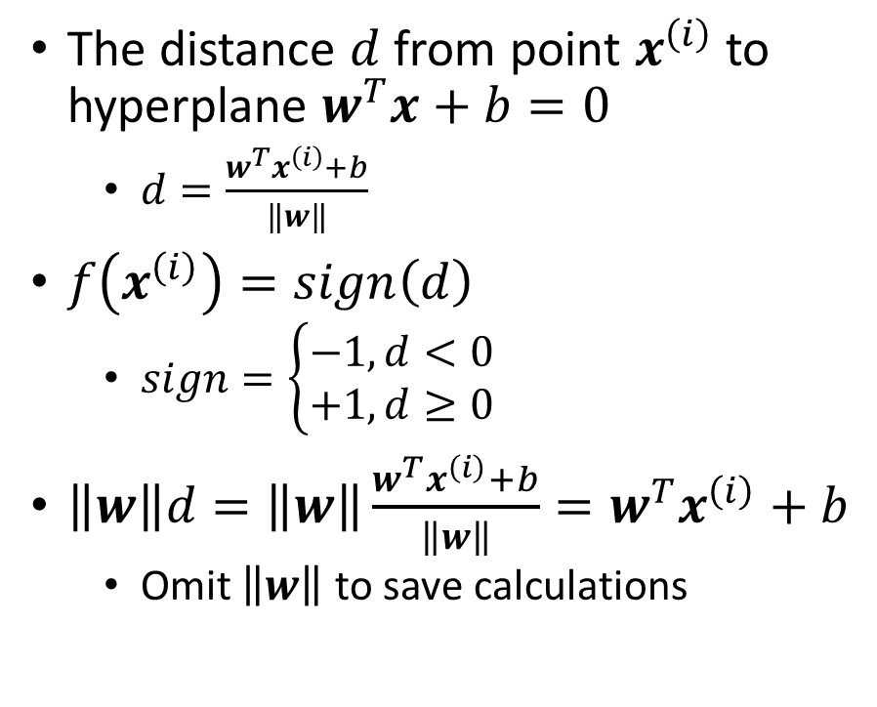


Distance
The distance $d$ from point $x^{\left(i\right)}$ to hyperplane $w^{T}x+b=0$
$d=\frac{w^{T}x^{\left(i\right)}+b}{\left\|w\right\|}$
$f\left(x^{\left(i\right)}\right)=sign\left(d\right)$
$sign=\left\{\begin{aligned}−1, d<0 \\ +1, d≥0\end{aligned}\right.$
$\left\|w\right\|d=\left\|w\right\|\frac{w^{T}x^{\left(i\right)}+b}{\left\|w\right\|}=w^{T}x^{\left(i\right)}+b$
Omit $\left\|w\right\|$ to save calculations
$$d>0$$
$$d<0$$

Slide 6
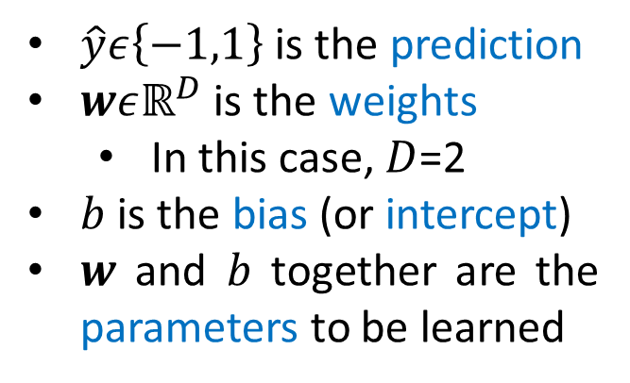
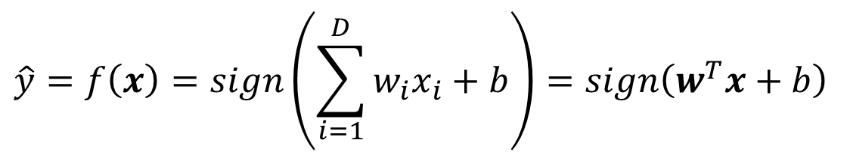
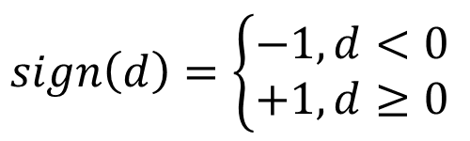
Perceptron
Model
$$\hat{y}=f\left(x\right)=sign\left(\sum_{i=1}^{D}{w_{i}x_{i}+b}\right)=sign\left(w^{T}x+b\right)$$
$$sign\left(d\right)=\left\{\begin{aligned}−1, d<0 \\ +1, d≥0\end{aligned}\right.$$
$\hat{y}ε\left\{−1,1\right\}$ is the prediction
$wεℝ^{D}$ is the weights
In this case, $D$=2
$b$ is the bias (or intercept)
$w$ and $b$ together are the parameters to be learned

Slide 7
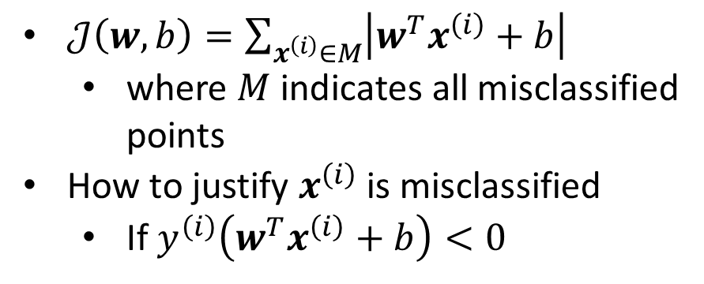


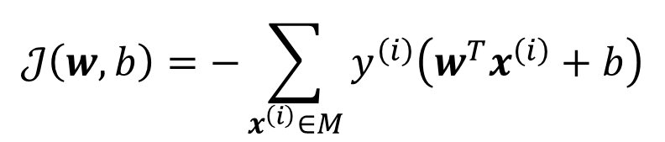
Cost Function
$𝒥\left(w,b\right)=\sum_{x^{\left(i\right)}∈M}{\left|w^{T}x^{\left(i\right)}+b\right|}$
where $M$indicates all misclassified points
How to justify $x^{\left(i\right)}$is misclassified
If $y^{\left(i\right)}\left(w^{T}x^{\left(i\right)}+b\right)<0$
Loss Function
$$ℒ\left(w,b\right)=−y\left(w^{T}x+b\right)$$
Cost Function
$$𝒥\left(w,b\right)=−\sum_{x^{\left(i\right)}∈M}{y^{\left(i\right)}\left(w^{T}x^{\left(i\right)}+b\right)}$$
$$y^{\left(i\right)}\left(w^{T}x^{\left(i\right)}+b\right)<0$$

Slide 8
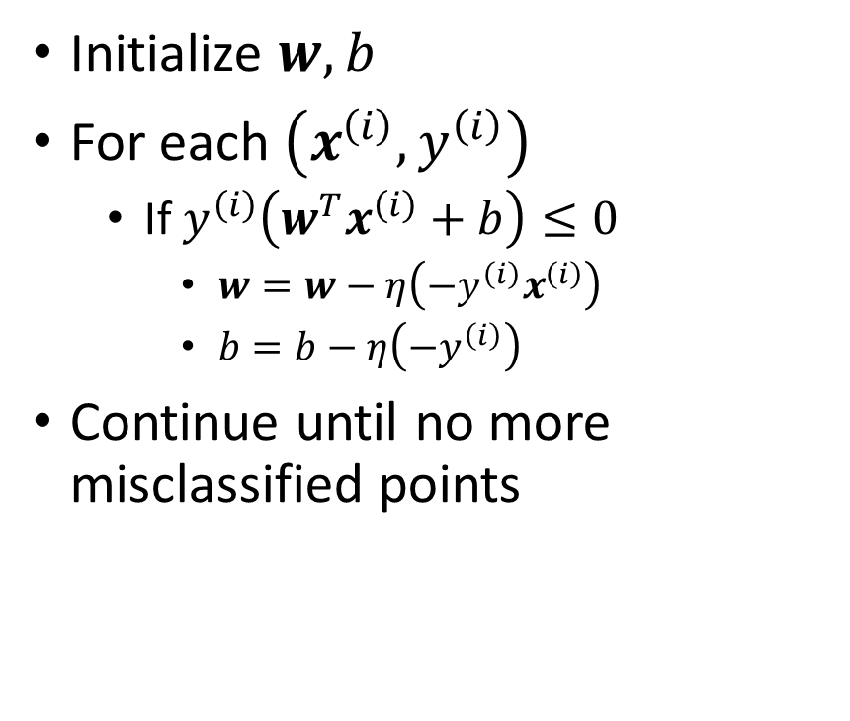
Optimization
Initialize $w, b$
For each $\left(x^{\left(i\right)},y^{\left(i\right)}\right)$
If $y^{\left(i\right)}\left(w^{T}x^{\left(i\right)}+b\right)≤0$
$w=w−η\left({−y}^{\left(i\right)}x^{\left(i\right)}\right)$
$b=b−η\left(−y^{\left(i\right)}\right)$
Continue until no more misclassified points

Slide 9


Summary
Drawbacks
Empirically, it does not find the best solution
Try to find the best one = Support Vector Machine (SVM)
Points must be linearly separable
Employ activation functions = Neural Networks (NN)
It only supports binary classification

Slide 10
Thank you！

